Slide 1

Professional Development Week
Notes:
This week is to give you the tools to market yourself as a web developer

Slide 2
Week Overview
Day 1
Day 2
Day 3
Day 4
Day 5

Slide 3

Monday
Journey to Becoming a Developer
Life Maps Activity
What Brought You Here Today!?
Elevator Pitch
Learning to tell your story
Will help you prepare for all of the other tasks throughout the week.
Transferable Skills - Mining Exercise
What makes me unique?
Prepping for Resume Writing

Slide 4
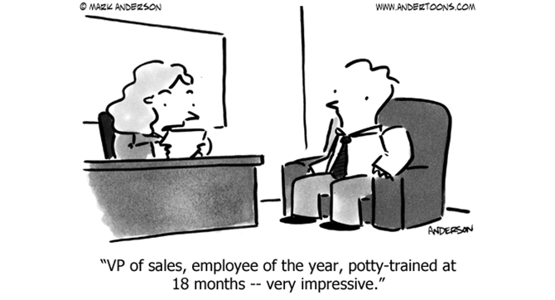
Tuesday
Job Search & Getting the Interview
The Tech Industry - An Outlook
Technical Recruiter Panel
Tech Jobs & Where to Find Them
Resume
Format, Format, Format
Catching the reader’s attention.
Focusing on thorough yet concise.
Tailoring to the job you want.
Cover Letters
Tying your experience together

Slide 5
Wednesday
Job Search – The Interview
Informational Interviews
How to introduce yourself to companies & the industry
Behavioral Interview
Tackling Truth & Demonstrating Skills
Examples, Examples, Examples
Technical Interview Techniques
Focus is on how you think, not what you’ve memorized
Portfolios
Your work, your personality and style

Slide 6
Thursday
Building Relationships
Tech Talks
Daniel & Doug will share example talks!
LinkedIn
The World’s Largest Professional Network: Are you on it?
How to network well using LI
Networking for the Introvert
Negotiation
It’s normal, don’t worry.
Rob will give advice!

Slide 7

Friday
The Internship Process & Beyond
Internship Process & Job Search Plans
Understanding the next steps
TechHire Partnership Presentation
San Diego Workforce Partnership Presentation
One-On-Ones w/ Bryan
Career Services Intake/ Q&A
Internship Company Presentations
3 Company Presentations for Internship

Slide 8

Beyond Professional Development Week
Please use this week’s Work Sessions productively! You have plenty of time to get things completed this week!
We can meet one-on-one for interview practice & professional document reviews this week & next.
As a reminder, all presentations from this week will be accessible in the your class folder from here on out: https://drive.google.com/drive/folders/1qMK5yrTPixrTnrd__XfMb9C28X8zvB2m?usp=sharing

